Slide 1
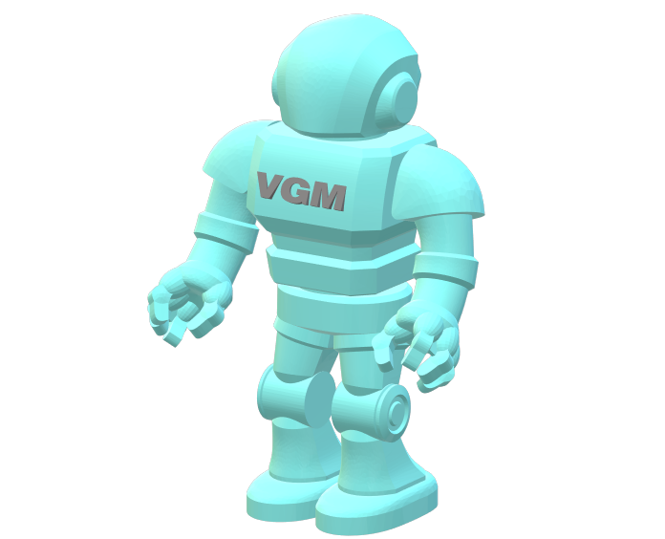
Vectric Gadget Man Dovetail Maker Version 5.30
May 2020

Slide 2

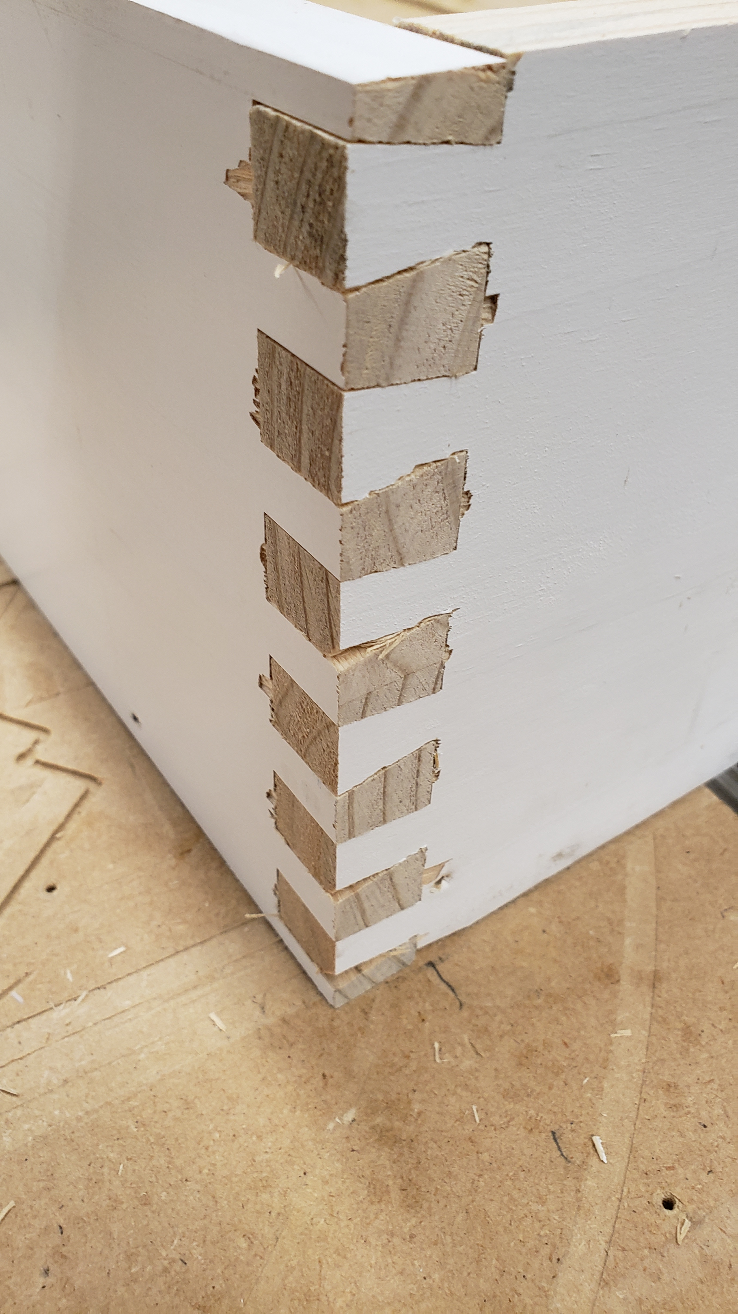
Dovetail Gadget Agenda
Job Setup
Running the Dovetail Gadget
Joint Setup
Making the Toolpaths
Testing the Fit
Please Note: This Gadget builds a Dovetail Joint by controlling the number of Tails and Pins equally over the size of material by entering the number of dovetails in the joint. The Bit selected plays a large role in the joint settings.

Slide 3
Revision History
Version 5.30
Moved Dovetail Tool database from “ini” file to the Registry
Version 5.20
Backer board capability for the prevention of chip out when cutting side material with dovetail cutting it
Left and righthand orientation for cutting the front board pins
Front pin fit adjustment capabilities
Additional code clean up and error trapping
Updated documentation (Wiki and pdf)

Slide 4
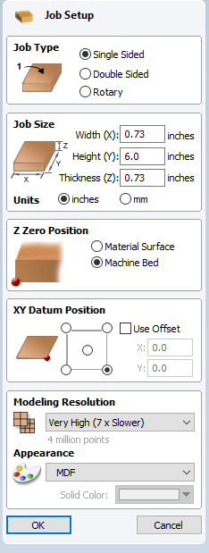
Dovetail Gadget Job Setup
Job Size – Width: Set to your material thickness
Job Type – Set to ‘Single Sided’
Milling operation is on the End of the material
Job Size – Height: Set to your material Width
Job Size – Units: Set to Your Units
Job Size – Thickness: Set to your material thickness
Z Zero Position – Set to ‘Your Style of Milling’
I use ‘Machine Bed’
XY Datum Position –Set to your Mill
I use the Lower Right on my Mill configuration

Slide 5
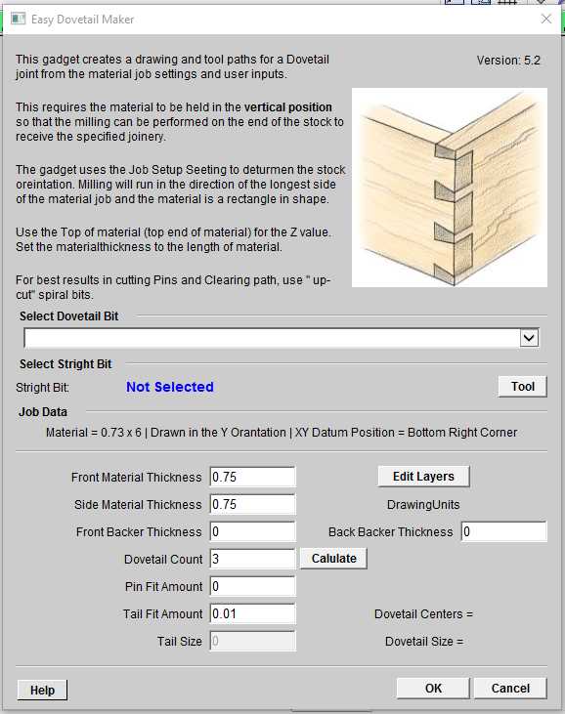
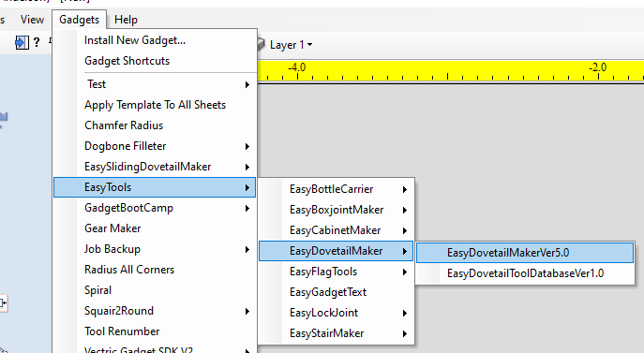
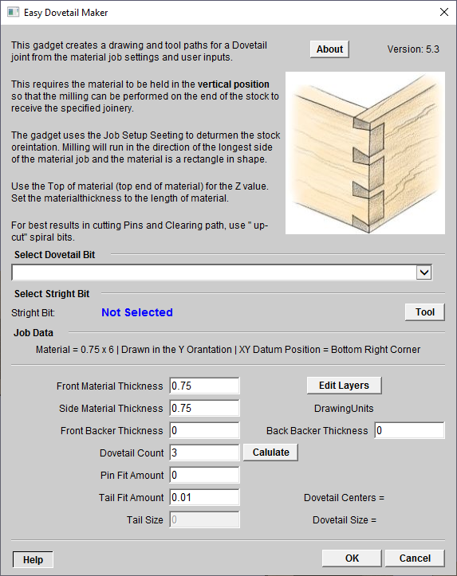
Dovetail Gadget Running the Dovetail Gadget
Version 10 or higher - Select Tool From The Tool Database
----------------------------
Version 9 or lower – Enter The Tool Diameter
Run Easy Dovetail Gadget

Slide 6
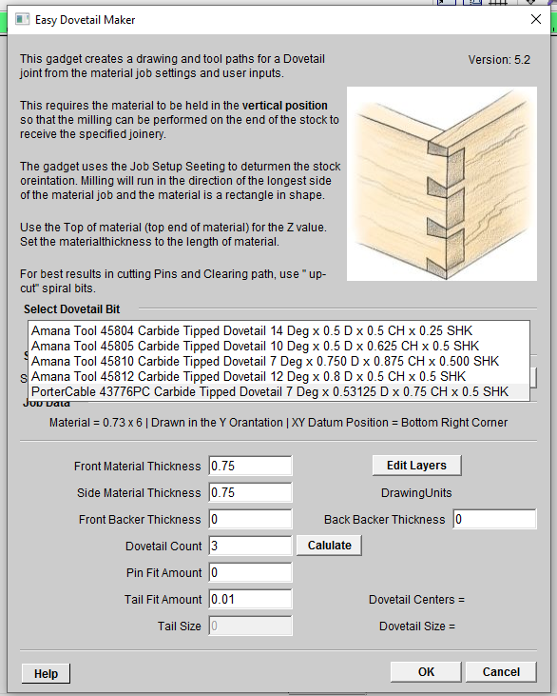
Dovetail Gadget Running the Dovetail Gadget
Drop the list to select a Dovetail From The Tool Dovetail Database
Select a Dovetail bit

Slide 7
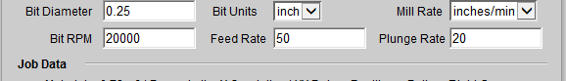
Dovetail Gadget Running the Dovetail Gadget
Version 9 – Enter the tool data for the straight bit
Version 10 - Select a straight Tool from the standard Tool database

Slide 8
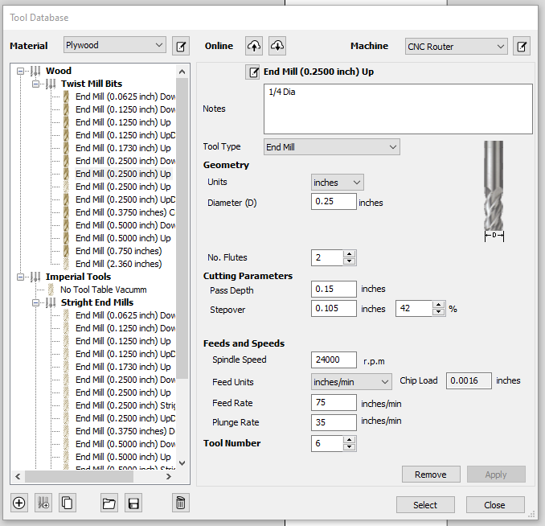
Dovetail Gadget Running the Dovetail Gadget
Select a Tool Diameter smaller or equal to the slot size. You may have to re-select if required

Slide 9
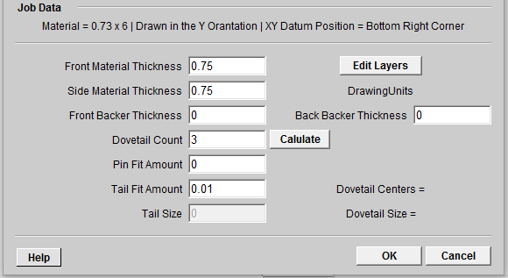
Dovetail Gadget Running the Dovetail Gadget
Note: Job data is displays here
Displays the Layer Editor
Note: Front and Side material thickness can be adjusted based your needs
Backer Material Thickness for Side Dovetails Milling
Enter the number of Dovetail for the joint
Select the Calculate button to display the Joint data
You can adjust the fit with entering a value here

Slide 10
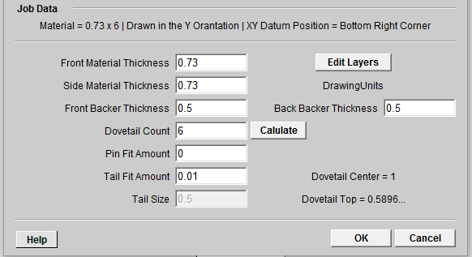
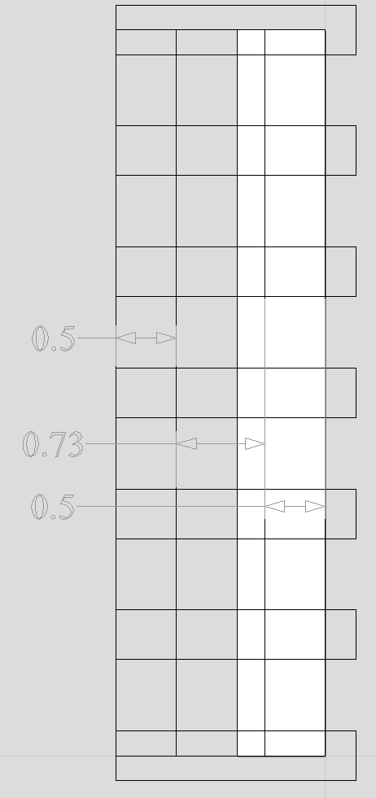
Dovetail Gadget Running the Dovetail Gadget
Backer Materials are used to prevent chip out when milling Dovetails
0.73 Side Material
0.5 Back Backer Material
Dovetail Clearing Pockets
0.5 Front Backer Material

Slide 11
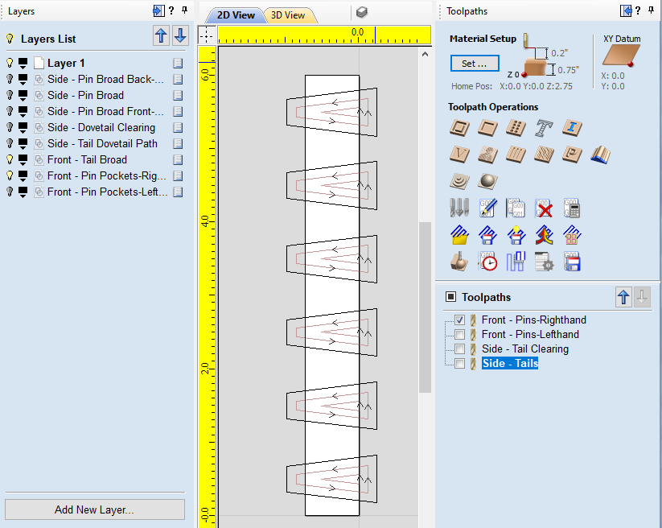
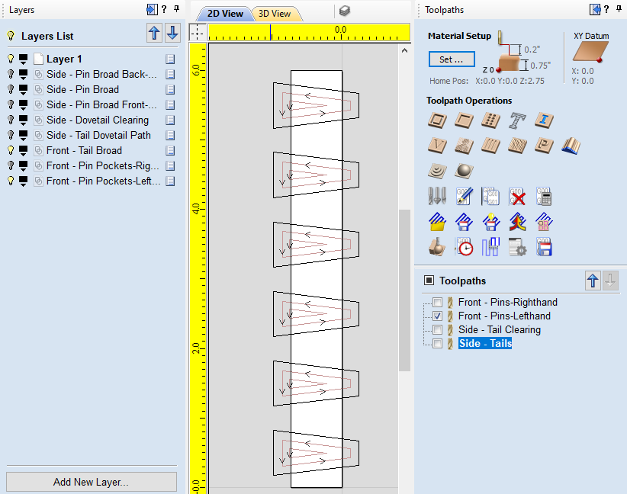
Dovetail Gadget Running the Dovetail Gadget
Right hand Pins
Left hand Pins

Slide 12
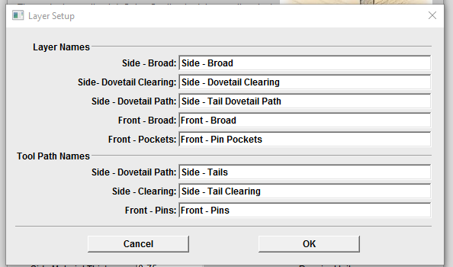
Dovetail Gadget Running the Dovetail Gadget
Edit Layer and Tool-path names

Slide 13
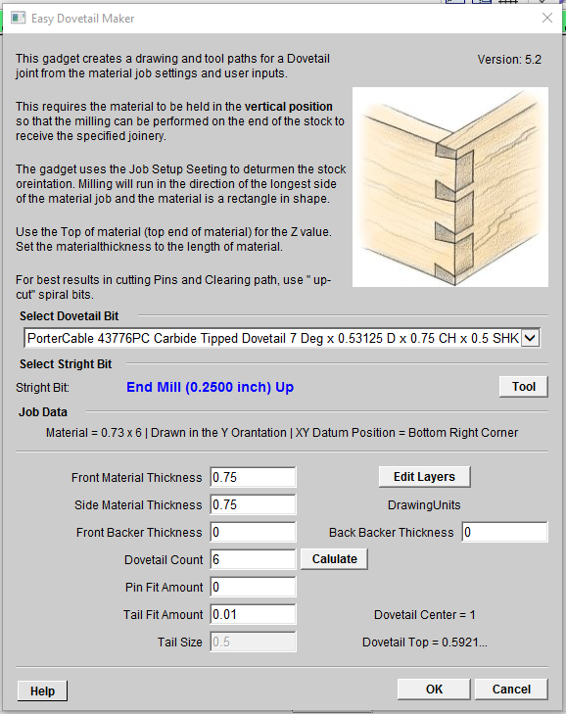
Dovetail Gadget Running the Dovetail Gadget
Select the Calculate button to display the Joint data
Enter the number of Dovetail for the joint

Slide 14
Dovetail Gadget Running the Dovetail Gadget
Select the OK button to build the drawing and toolpaths

Slide 15
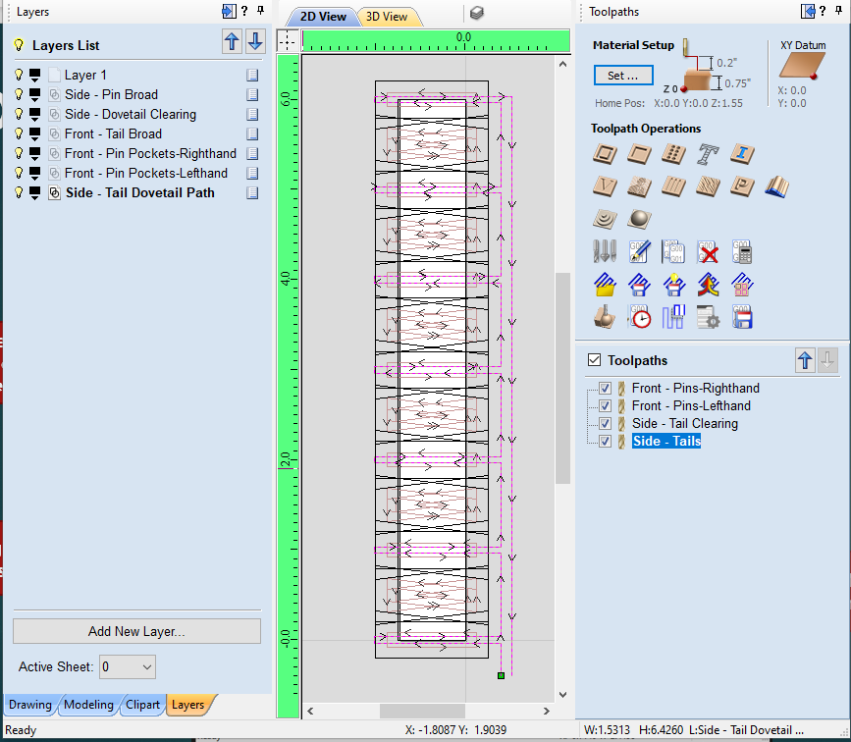
Dovetail Gadget
Note: The Layers are named so each milling of the Dovetail joint
Toggle on and off layers to display the Joint cuts
Note: The tool-paths for milling the dovetails

Slide 16
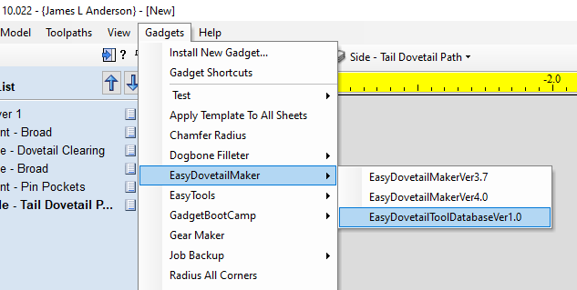
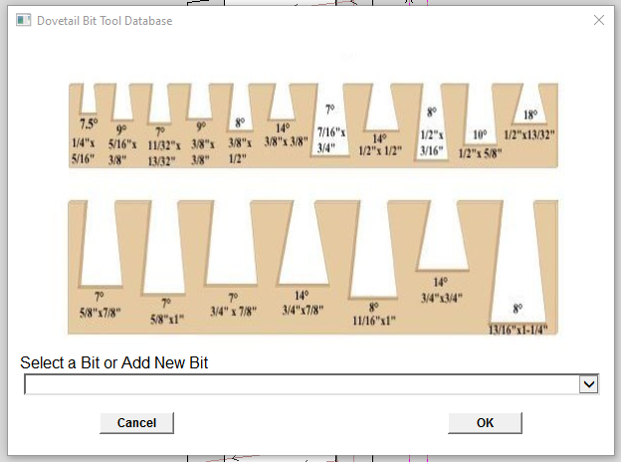
Dovetail Bit Gadget Adding and Editing Dovetail Bits
Open the Dovetail Tool Database Gadget
Select the Add New or Select a bit to edit

Slide 17
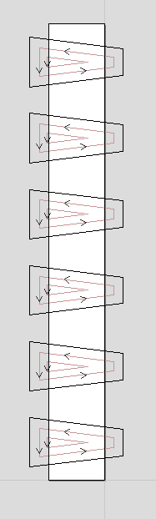
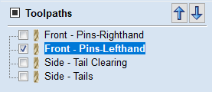
Dovetail Gadget Mill Setup
Note: The Pin Fit Amount (+/-) is integrated in the Front Pin geometry. Positive values will loosen the joint and negative values will tighten the joint
Note: The Milling is on the Front board
-
+

Slide 18
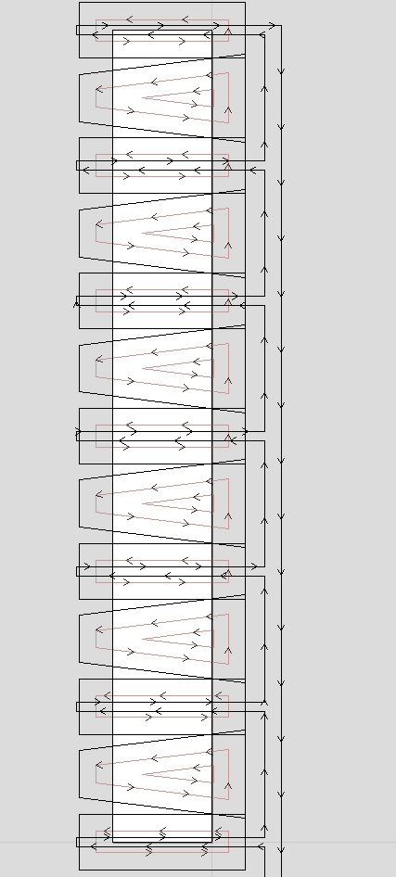
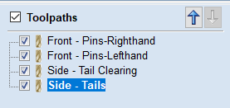
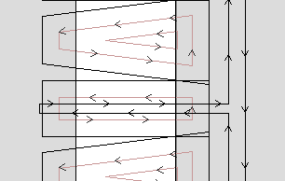
Dovetail Gadget Mill Setup
Note: The Tail Fit Amount is integrated in the Dovetail path geometry. The larger the Tail Fit Amount number the wider the Dovetail milling path
Note: Milling is on the Side boards

Slide 19
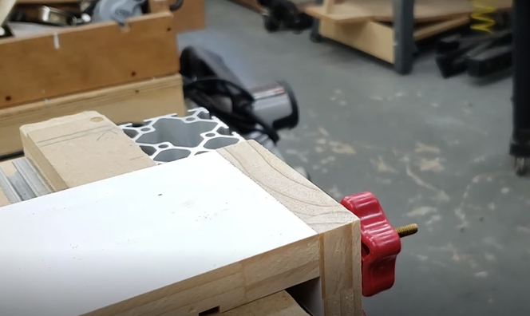
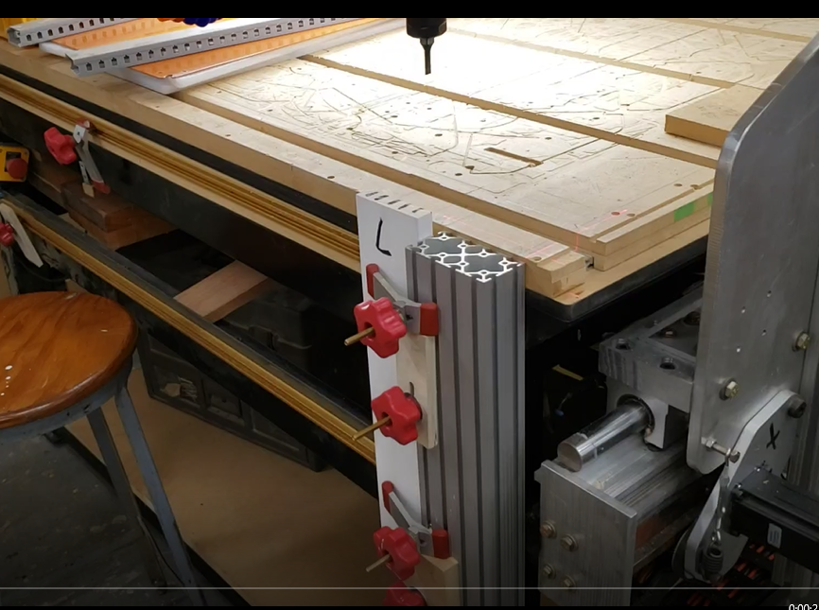
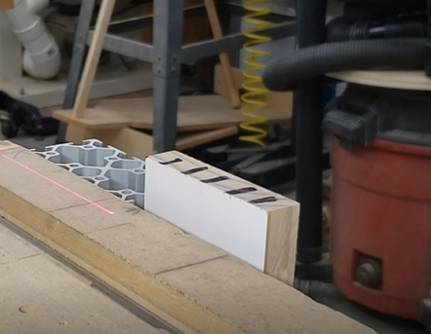
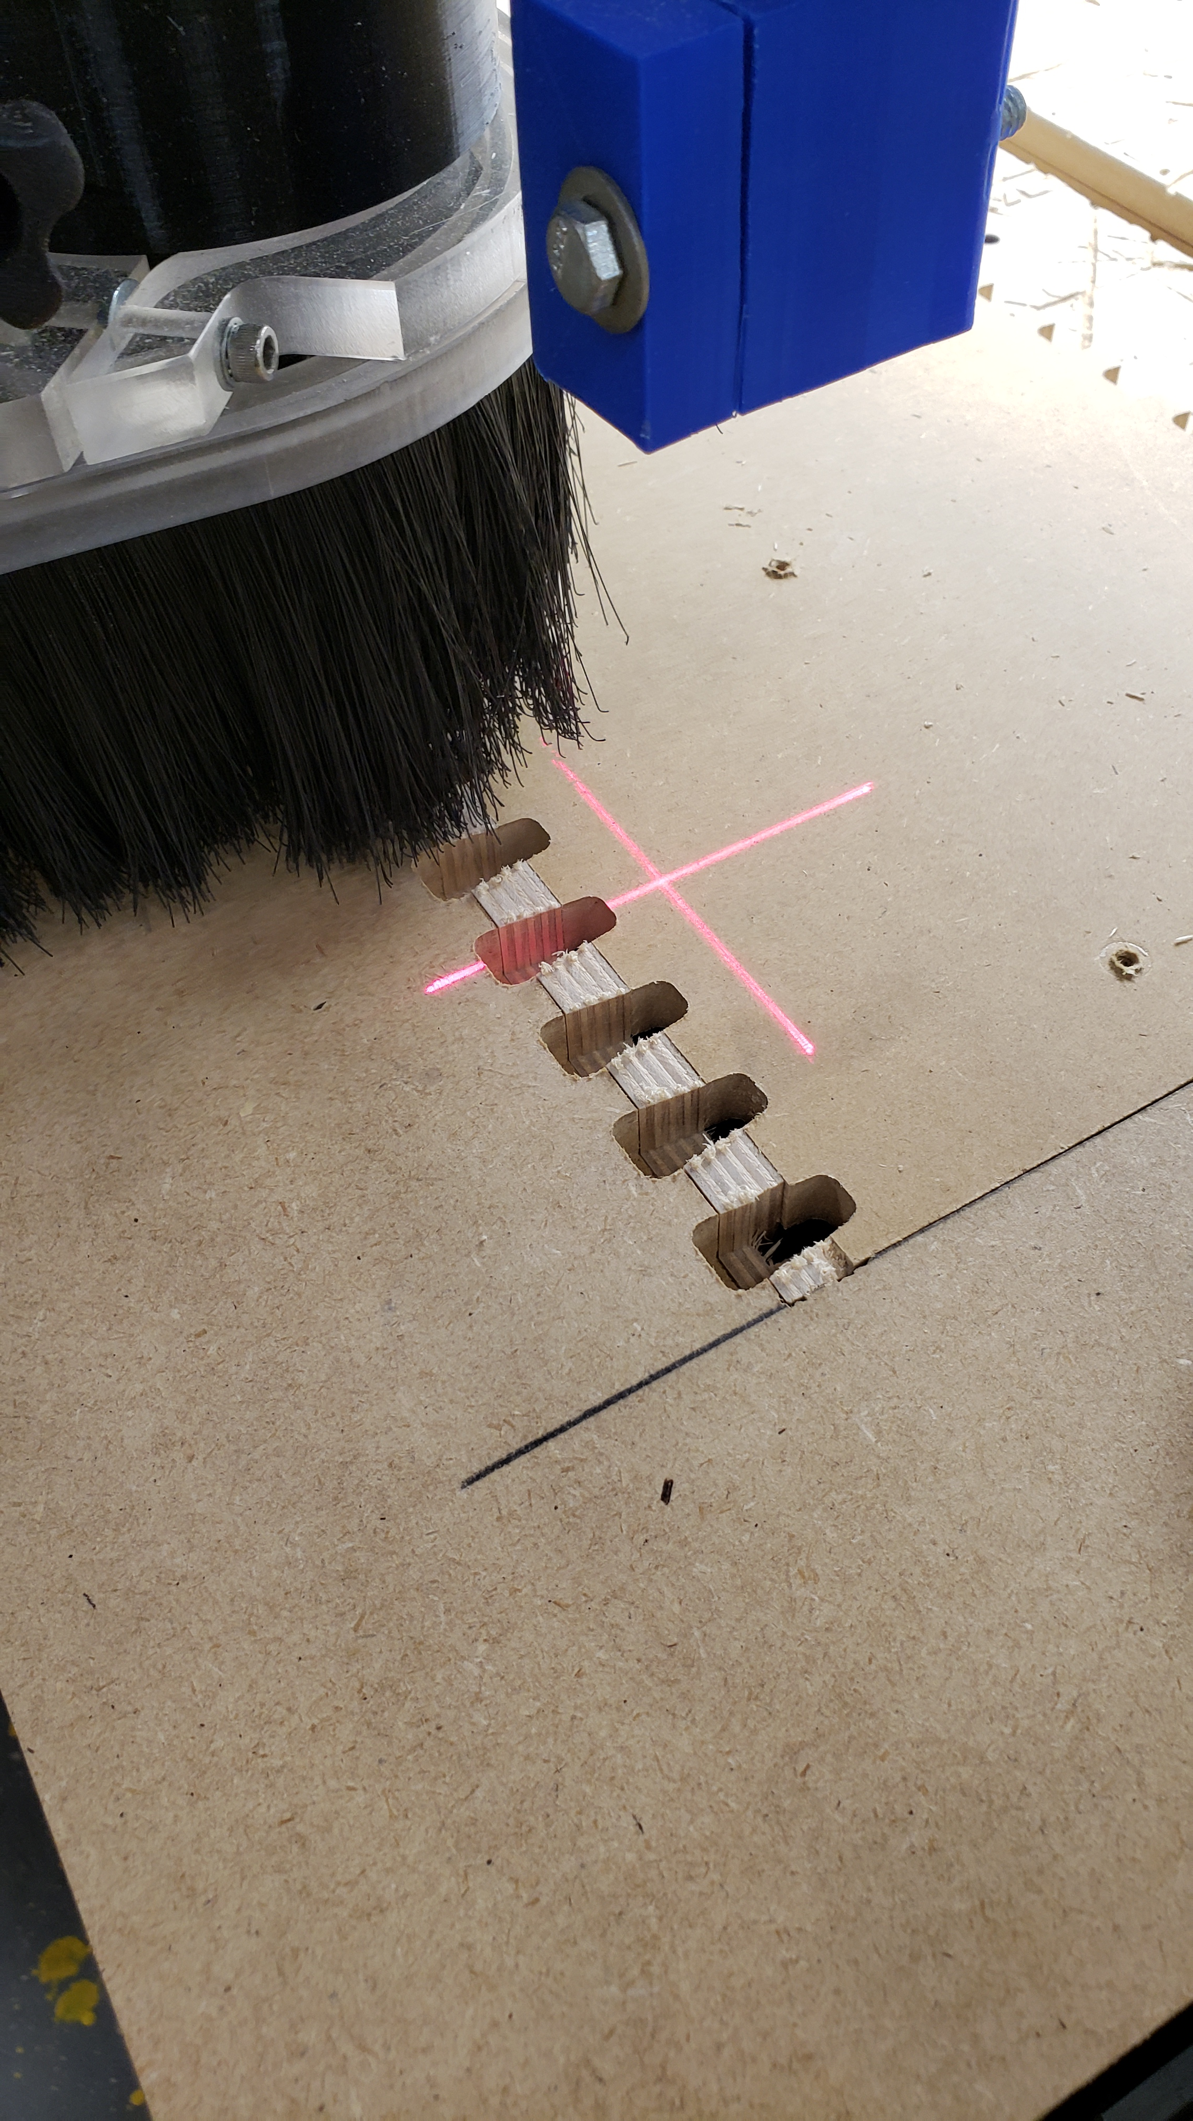
Dovetail Gadget Running the parts
Note: Use material to flush the top so it is projected above the mill table.
Note: Material is clamped to the front of the mill and is projected the thickness of the material above the mill table.
Note: Use Backer Boards to prevent chip out.

Slide 20
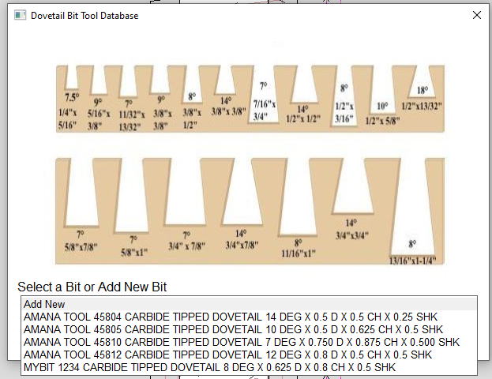
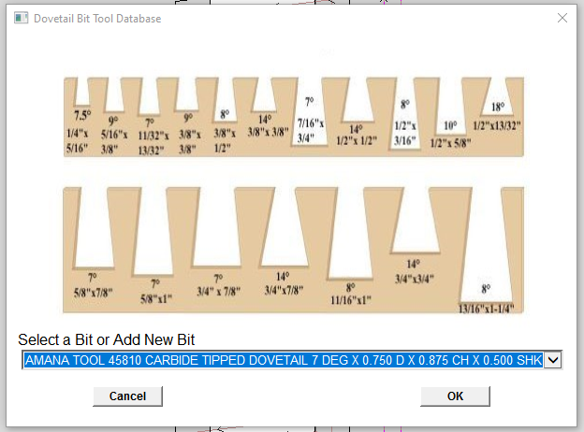
Dovetail Bit Gadget Adding and Editing Dovetail Bits
Select Add New or Select a bit to edit
Select the OK button to Open the

Slide 21
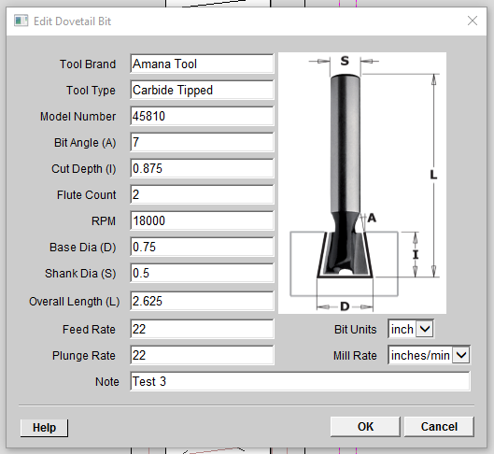
Dovetail Bit Gadget Adding and Editing Dovetail Bits
Update the tool data as needed
Select the OK button to save your changes

Slide 22
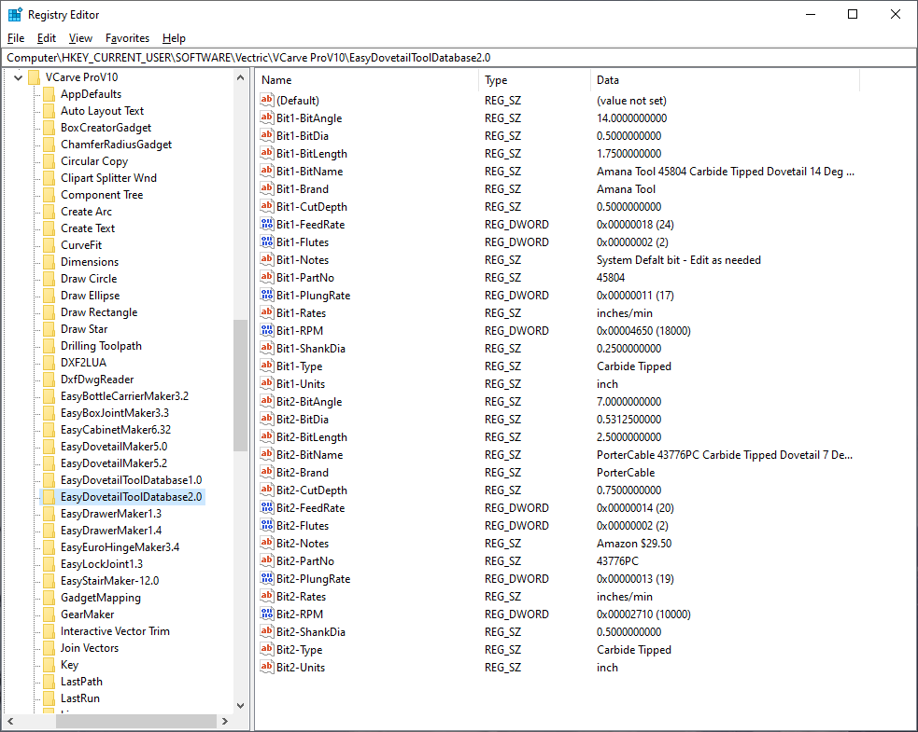
Dovetail Bit Gadget Adding and Editing Dovetail Bits
Note: If needed, You can edit the Dovetail bit database in the Registry Editor
Note: Your Application Name may be deferent
Computer\HKEY_CURRENT_USER\SOFTWARE\Vectric\VCarve ProV10\EasyDovetailToolDatabase2.0

Slide 23


